Slide 1



Statistical methods of global air pollution modeling
University of Utrecht, The Netherlands
Meng Lu

Slide 2
1. Introduction to air pollution mapping and data exploration hands-on 1 (10 mins): “getting ready” install packages, visualize data, data exploration: paired correlations, spatial dependence and scatterplot 2. Machine learning methods ensemble trees, mixed-effect models, artificial neural network, convolutional neural networks hands-on 2 + break (45 mins): “machine learning methods.” 3. Modelling process hands-on 3 (15 mins): “modelling process” hyper-parameter optimization, bootstrapping-based cross-validation, mapping and compare spatial patterns of different predictions

Slide 3
Introduction and data
Part 1

Slide 4
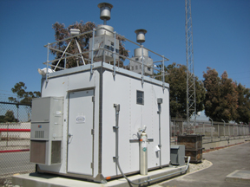

Predicting air pollution and analyzing the sources.
Land use regression (LUR)
$$y=β0+β1x1+β2x2+⋯+βnxn$$
Sensor measurements:
Station measurements
Mobil sensors
Remote sensing measurements:
OMI (250 km)
Tropomi (8 km)
…
GIS predictors:
Population
Road length within a buffer
Distance to roads
Traffic load
…

Slide 5
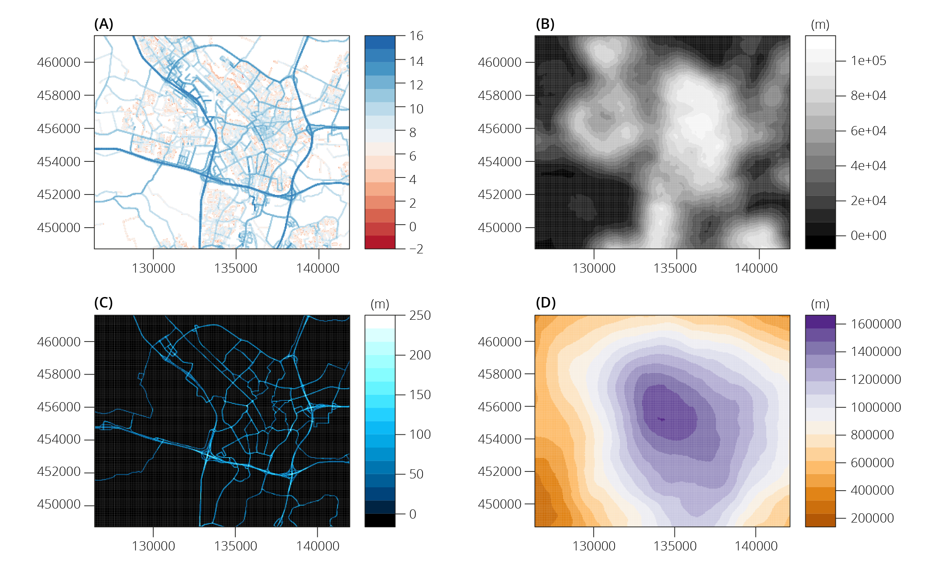
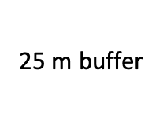
Buffered predictors
25 m buffer
1000 m buffer
Notes:
x

Slide 6
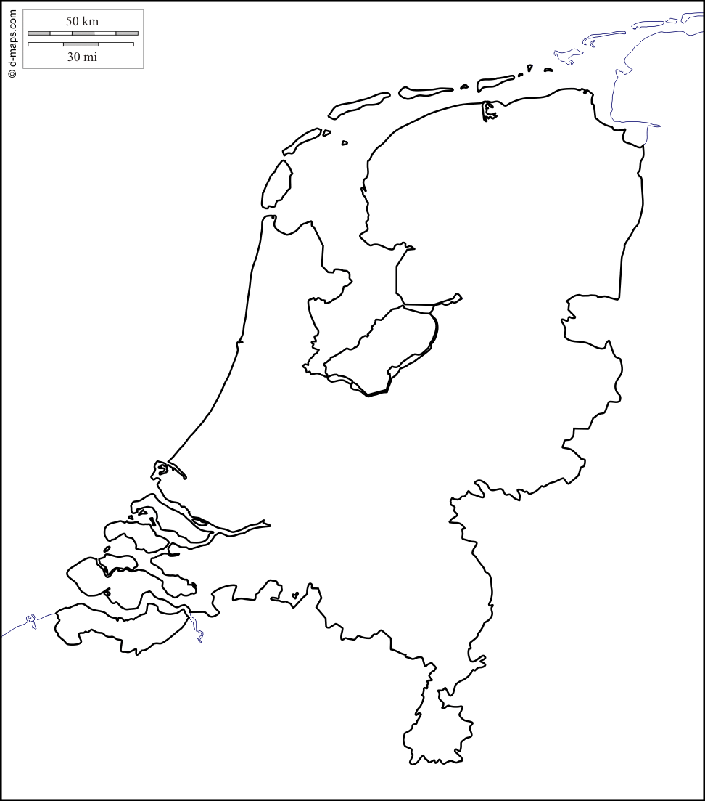
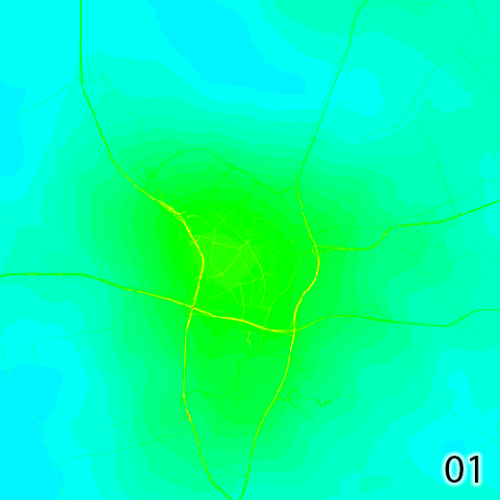

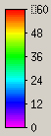
LUR prediction of NO₂
Spatiotemporal dynamic of air pollution showing road effects
60
30
0
0
5km
Hour
5 m resolution

Slide 7

Ground monitor Data: OpenAQ
(2017)

Slide 8
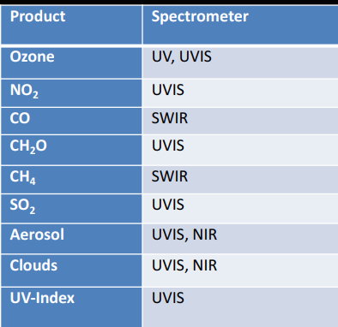
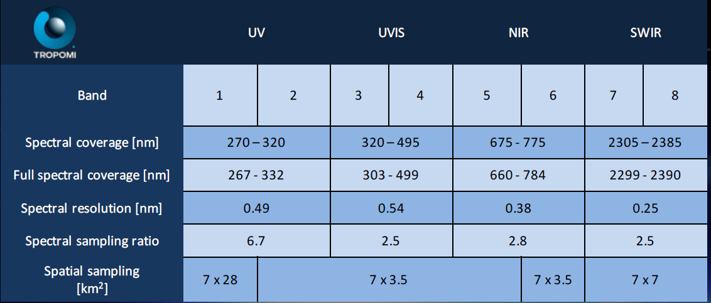
Tropomi
Feb 2018 to Jan 2019

Slide 9
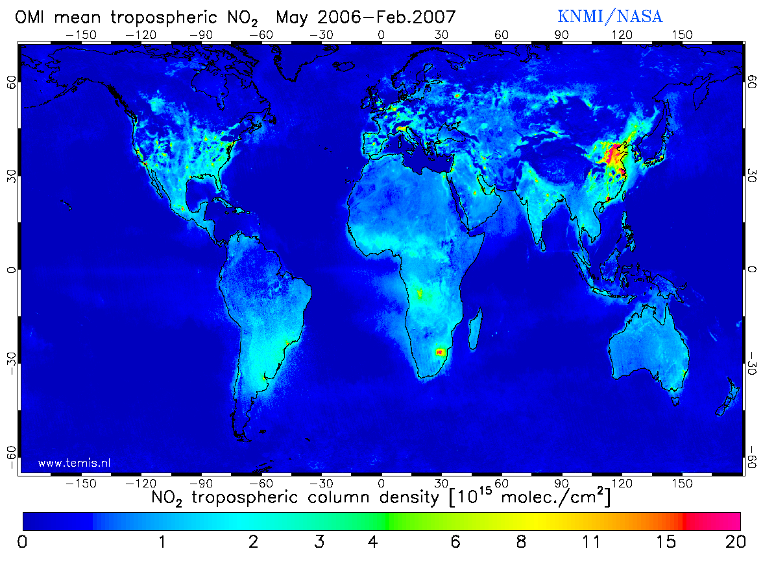
Remote sensing measurements: OMI (Ozone Monitoring Instrument)
Date of Launch | 15 July 2004
At nadir 13 km × 24 km
NO2, SO2, BrO, OCIO, O3 (36 km × 48 km)
Spectral bands: ultraviolet and visible (270 to 500 nm)
Zoom in mode 13 km× 12 km
Daily global coverage

Slide 10
Surface product based on remote sensing and GEOS-CHEM
Chemical transportation models: GEOS-CHEM
global prediction are of coarse resolution - > integrating RS data
Surface NO2 product made using GEOS-CHEM together with GOME, SCIAMACHY, and GOME-2 satellite instruments. http://fizz.phys.dal.ca/~atmos/martin/?page_id=232
The surface product is used in our model.

Slide 11
Geospatial predictors
Road and industrial area from OpenStreetMap (vector)
Earth nightlight (500 m)
as a proxy for socio-demographics
Population (100 m)
From human settlement layers
Wind speed and temperature
Elevation: SRTM (90 m)

Slide 12
Hands-on 1: Setup and data visualization
In the folder R_scripts
Data_visualize/Openaq.Rmd:
query station measurements from OpenAQ API
Data_visualize/ Plot_RS.Rmd:
visualize TROPOMI and OMI satelite measurements
Introduction/GeoHub2020.Rmd:
run the chunks till “modelling” for data exploration

Slide 13
Machine learning 1980, computer science, machine learning, neural networks, zipcode recognision problem, bell lab
Part 2

Slide 14
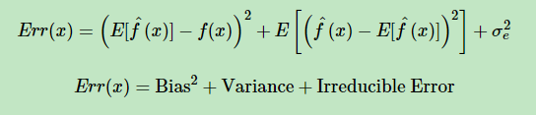

Bias-variance trade-off
All algorithms are affected by bias-variance trade-off

Slide 15




Machine learning

Slide 16
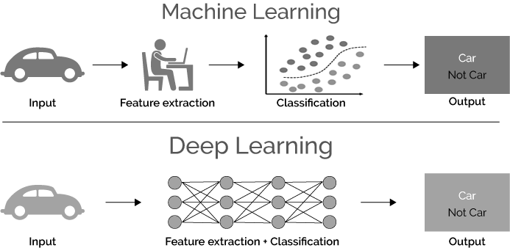
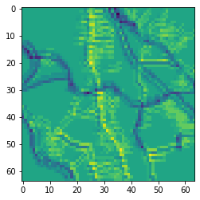
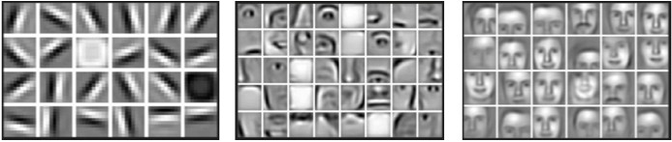
Go deep
Road density
Road structure

Slide 17
Regression trees
A decision tree
Features:
Non-parametric
Different kinds of variables
Redundant variables are ignored
Handle missing data
Small trees are easy to interpret
population
Hungry
> 1000/km²
yes
< 1000/km²
no
10.0
µg/m3
Traffic count
Do sports
Local food
> 500/hr
Yes
< 500/hr
No
22.5 µg/m3
20.0
µg/m3
sausage
Japanese food

Slide 18
Ensemble trees -- reducing model variance
Bagging
Random forest
Boosting
Dominance
Boosting > Randomforest > bagging > single tree
Is it true that boosting trees are always better than the randomforest?

Slide 19
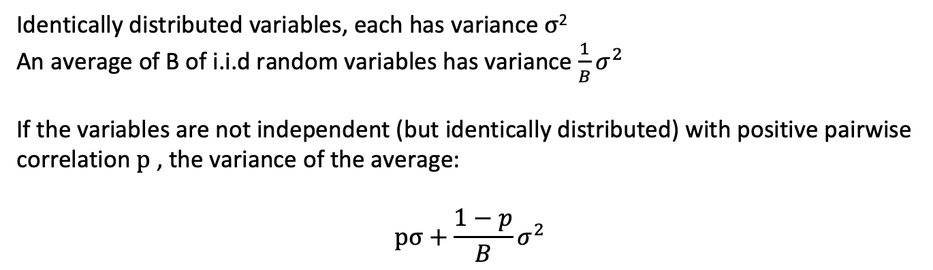
Random forest
variance reduction
Identically distributed variables, each has variance $σ$²
An average of B of i.i.d random variables has variance $\frac{1}{B}σ^{2}$
If the variables are not independent (but identically distributed) with positive pairwise correlation $p$ , the variance of the average:
$$pσ+\frac{1−p}{B}σ^{2}$$
“the more uncorrelated, the more you bringing down the variance”.
(tunning parameter: number of trees, tree depth)

Slide 20
Random forest
Hyperparameters:
Number of trees
Number of variables
Minimum observations at leaf
R_scripts/Introduction/shiny_randomforest/app.R

Slide 21
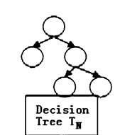
More details
For each tree:
Bootstraping sample D* from the training data D
Draw m* variables randomly from all variables m, pick the best split-point (variable), split the node.
Limitation:
Bias towarding variables with many splits or missing variables, does not assess uncertainty
Variations:
Recursive partition trees:
Hypothesis testing of dependency between variables and resursively fitting the splitting weight
Baysian based sampling and variable selection:
Baysian framework for 1 and 2
Quantile random forest:
Estimate quantiles (beyond the conditional mean)

Slide 22
Stochastic gradient Boosting
-- Reweight based on the previous trees, stage-wise fitting
Each successive tree is built for the prediction residuals of the preceding tree in an adaptive way to reduce bias.
.
initial:
r = y
fit a regression tree to r: g(x)
for each tree:
f(x) = e*g(x)
r = r – f(x)
(Stochastic) Gradient Boosting
approach the gradient of the loss function (e.g. binomial, logistic, poison) by trees.
Each consecutive tree is built for the prediction residuals (from all preceding trees) of an independently drawn random sample
(r: residual; e: learning rate)

Slide 23

Learning Rate
Stochastic Gradient Boosting
Each consecutive tree is built for the prediction residuals (from all preceding trees) of an independently drawn random sample

Slide 24
XGboost
Exteme gradient boosting
Idea
Not only impurity, but also model complexity
obj(θ) = L(θ) + Ω(θ)
Features
Parallel computation
Support dense and sparse matrix
Can costomize objective fucntions

Slide 25
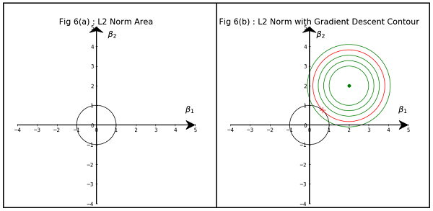
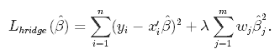
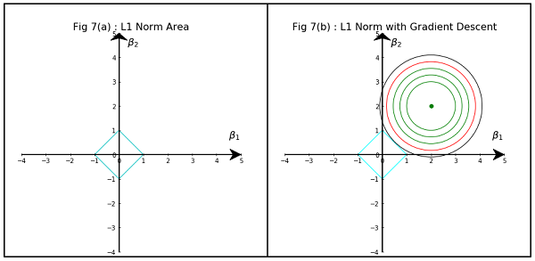
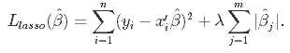
Control overfitting: Regularization
Ridge regression
Lasso regression

Slide 26
Hyperparameters
nrounds:
Controls the maximum number of iterations.
Eta:
learning rate,
max_depth:
the depth of the tree.
Gamma:
Penalizing large coefficients which don't improve the model's performance.
Alpha L1 norm (Lasso)
Lambda L2 norm (Ridge)

Slide 27
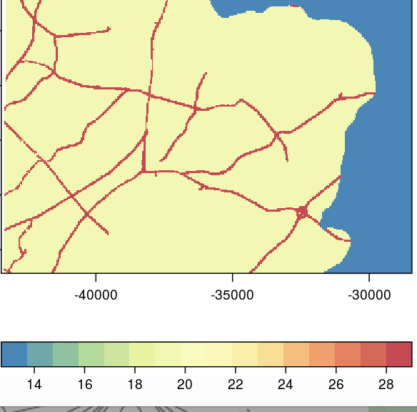
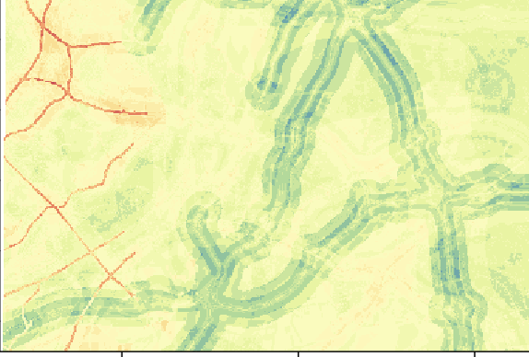
R_scripts/Introduction/shiny_xgboost/app.r
1 tree
100 trees
https://lumeng0312.shinyapps.io/xgboost/?_ga=2.179522658.79817579.1592385947-986486774.1592216474
Please try this QR code if the link does not work.

Slide 28
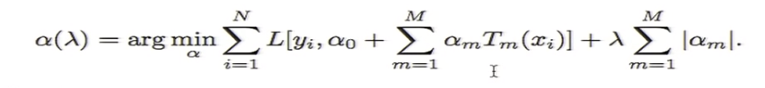
Postprocessing
Lasso regularization of regression trees
--- discarding trees that are not useful

Slide 29
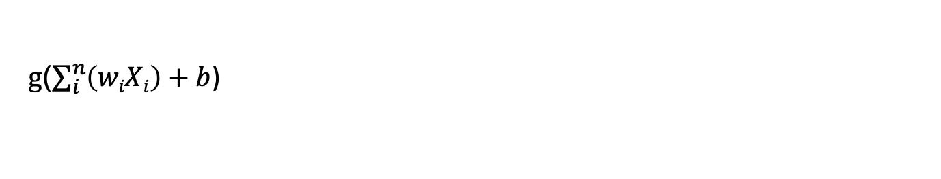
Deep learning: neural networks
A perceptron
Bias b: x₁ = 1
g($\sum_{i}^{n}{\left(wiXi\right)+b}$)

Slide 30
Learning: optimizing the loss
Regression:
Mean Squared Error
Classification:
Cross-entropy

Slide 31
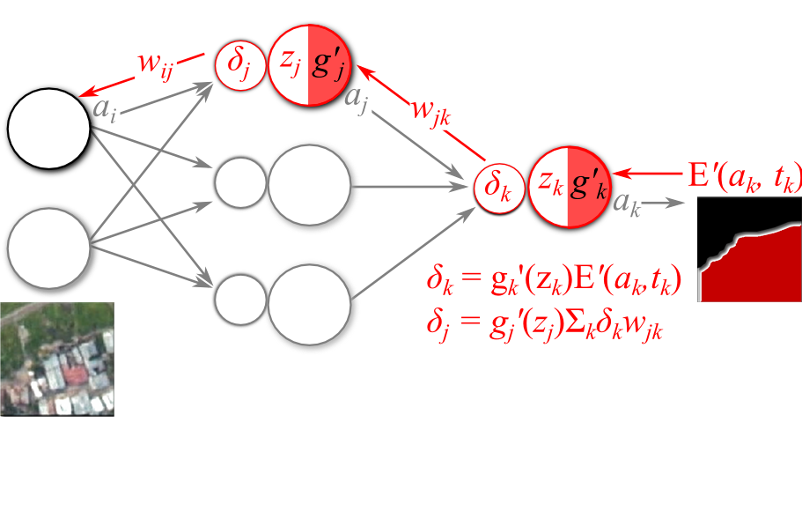
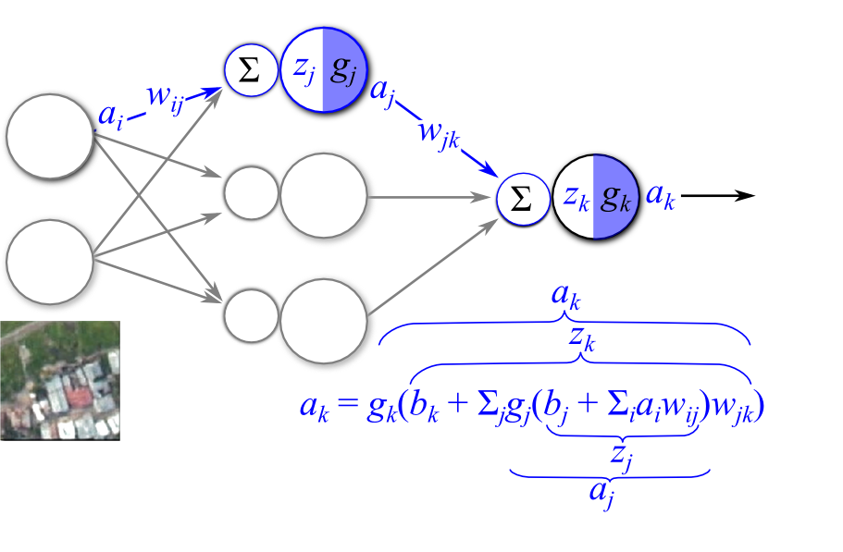
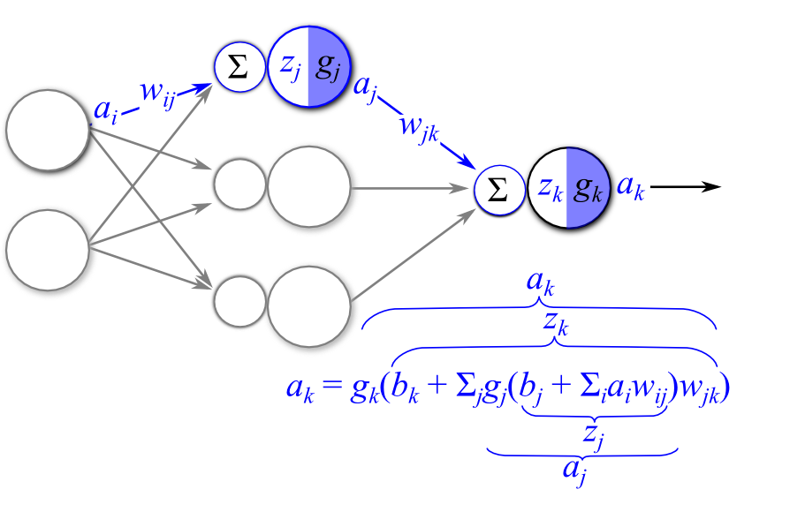
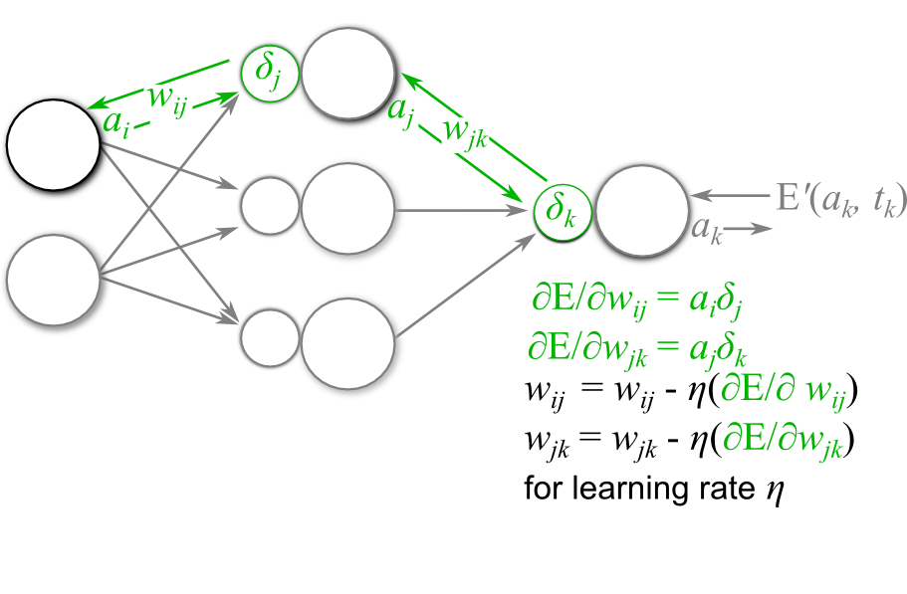
Deep learning: neural networks

Slide 32
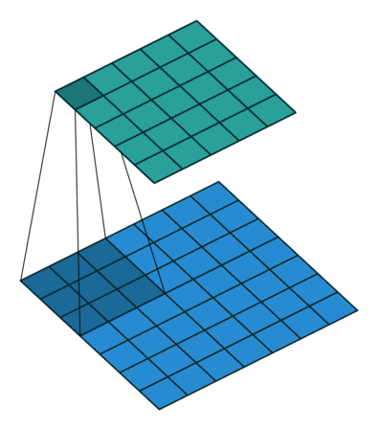
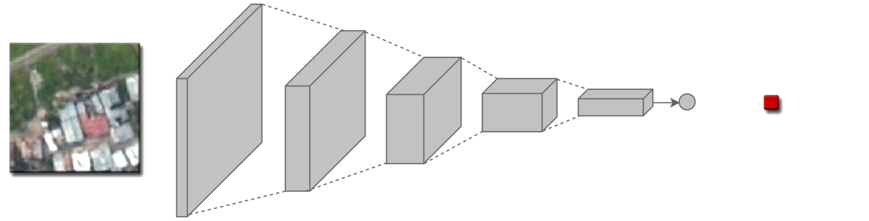
Convolutional neural networks
Convolutional filter
R_script/convolution_filter/convolution_illusrated

Slide 33
Regularization
Batch normalization
Drop-out

Slide 34
ResNet
Making networks deeper

Slide 35
Hands-on 2: Ensemble tree-based methods
From R_scripts/Introduction/GeoHub2020.Rmd:
run the chunks from “modelling” for different modelling approach.
Kaggle notebook

Slide 36
Hands-on 3: Modeling process
From R_scripts/modeling process
You can find the three R markdown files corresponding to hyper-parameter tunning, cross-validation and mapping.

Slide 37
What can the machine learning methods tell? Partial dependence plot, trees, variable importance
Part 2 (2)

Slide 38
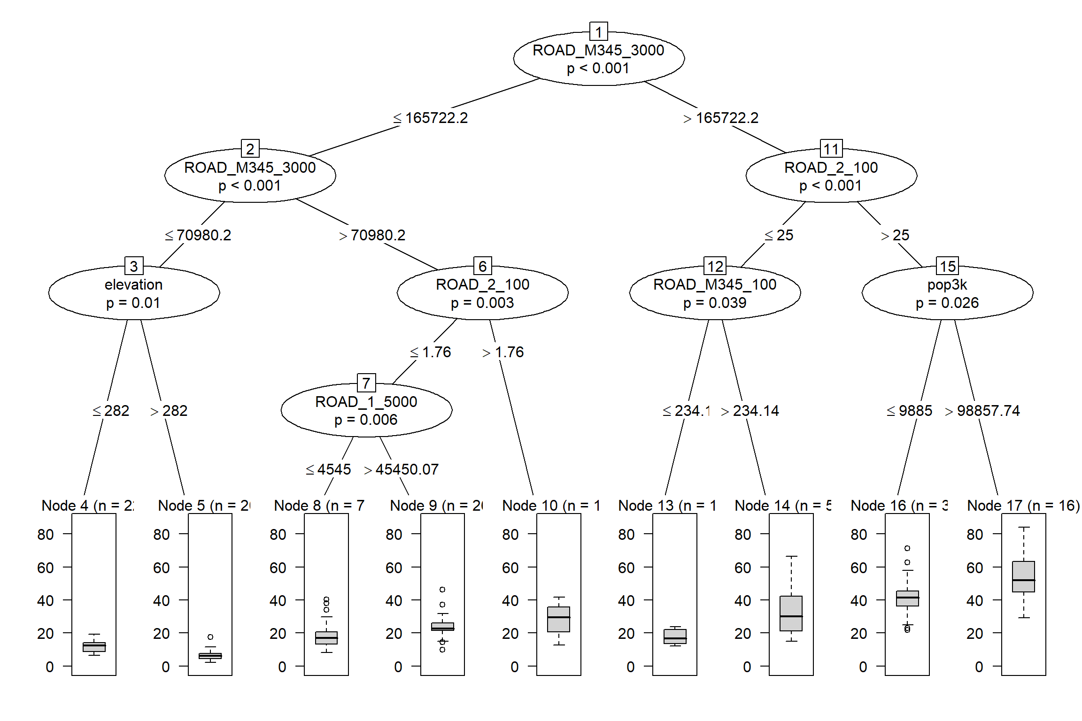
A closer look at the model
ROAD_M345: secondry
and local roads
Pop_: population
ROAD_2: primary roads
ROAD_1: highway
Visualizing a tree

Slide 39
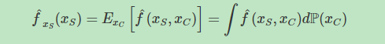
Partial dependence.
-- Shows the relationship between the target and a feature.
Xs : the features of the partial dependence function
Xc: the other features used in the machine learning model
Marginalizing the model output over the distribution of the features in set C,
Assumption: the features in C are not correlated with the features in S

Slide 40
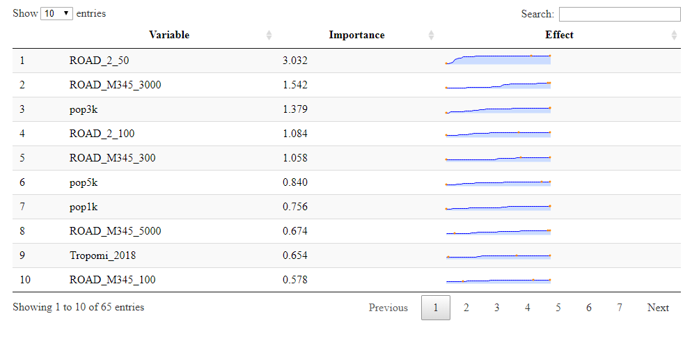

Slide 41
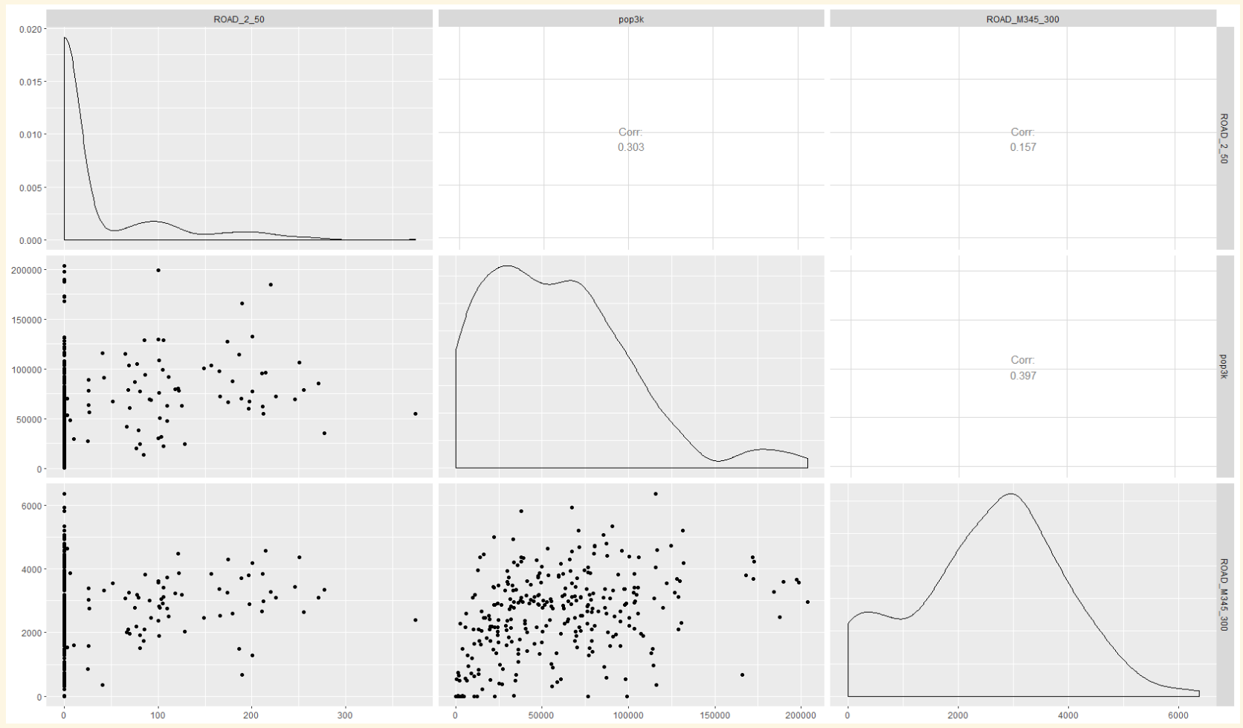
ROAD 2, 50m
Population, 3km
ROAD M345, 300m
Correlation:
0.3
Correlation:
0.16
ROAD M345, 300m
Correlation:
0.4
Population, 3km
ROAD 2, 50m
30m
120000m
5000m

Slide 42
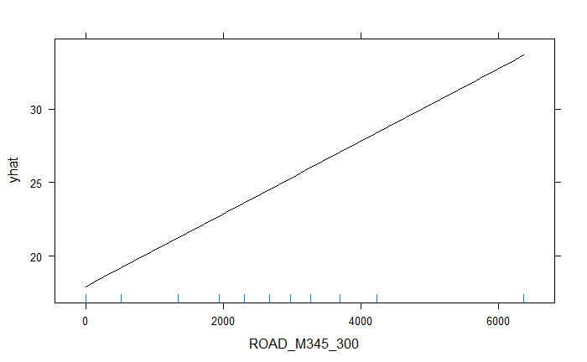
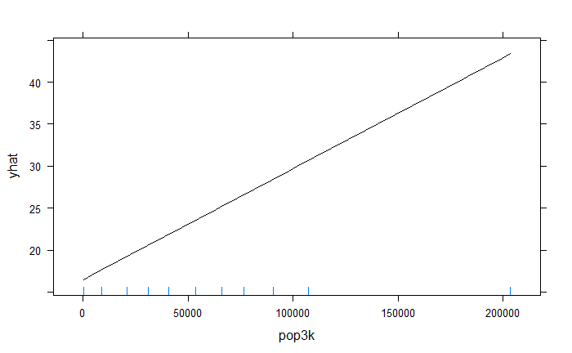
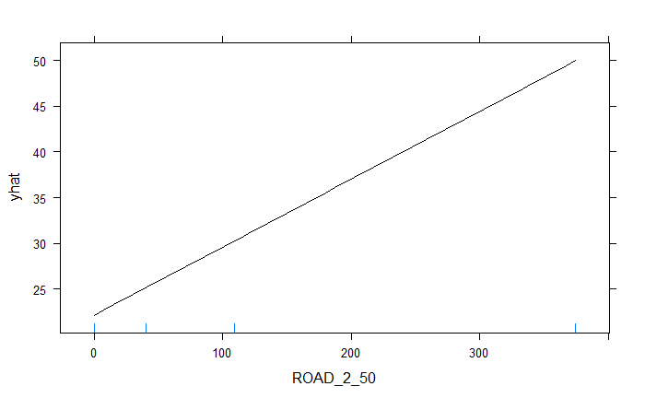
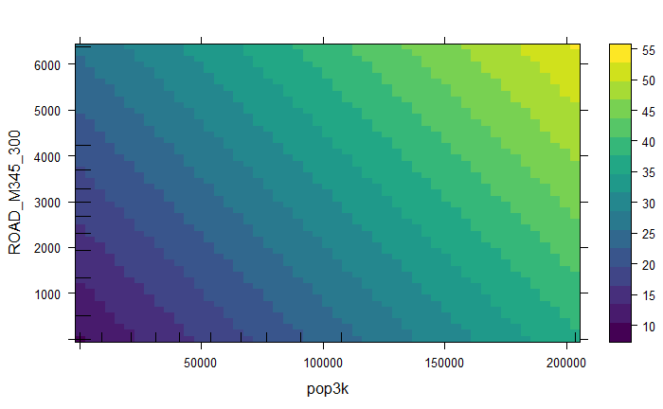
Partial dependent plots: Linear regression
ROAD M345, 300m
Population, 3km
ROAD M345, 300m
ROAD 2, 50m
Population, 3km

Slide 43
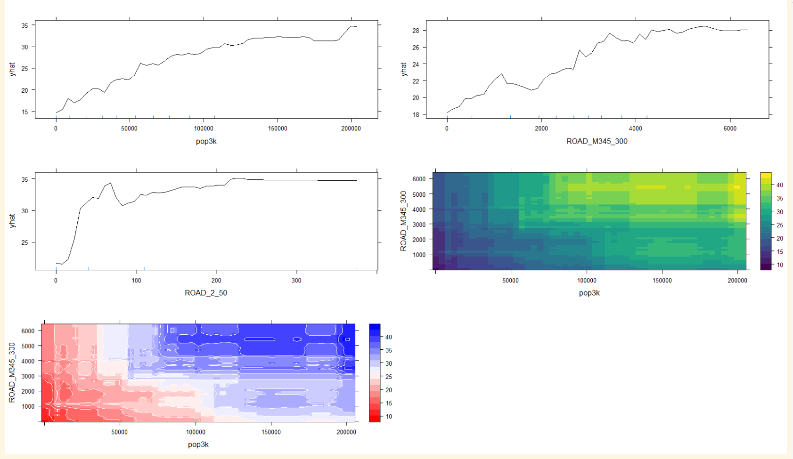
Partial dependent plots: Random forest
Population, 3km
120000m
ROAD M345, 300m
5000m
30m
ROAD M345, 300m
ROAD 2, 50m
Population, 3km
40
ROAD M345, 300m
4000
Population, 3km

Slide 44
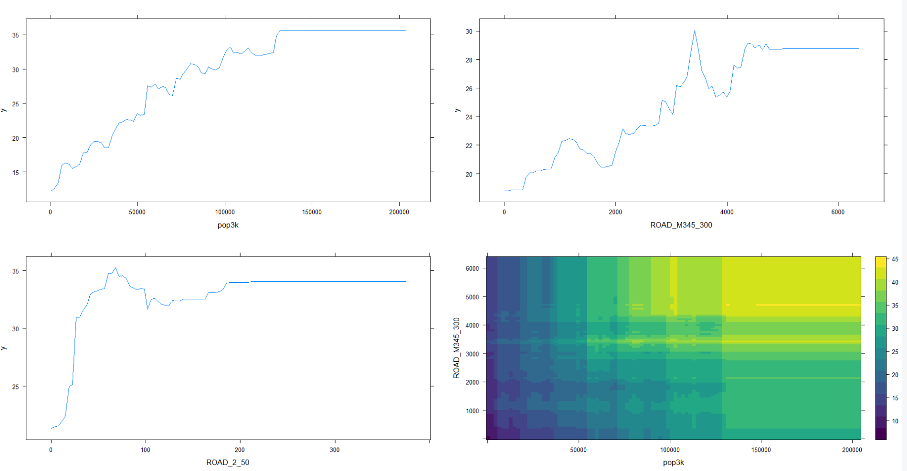
Partial dependent plots: stochastic gradient boosting
Population, 3km
120000m
ROAD M345, 300m
5000m
30m
ROAD M345, 300m
ROAD 2, 50m
Population, 3km

Slide 45
predicting and results
Part 3

Slide 46
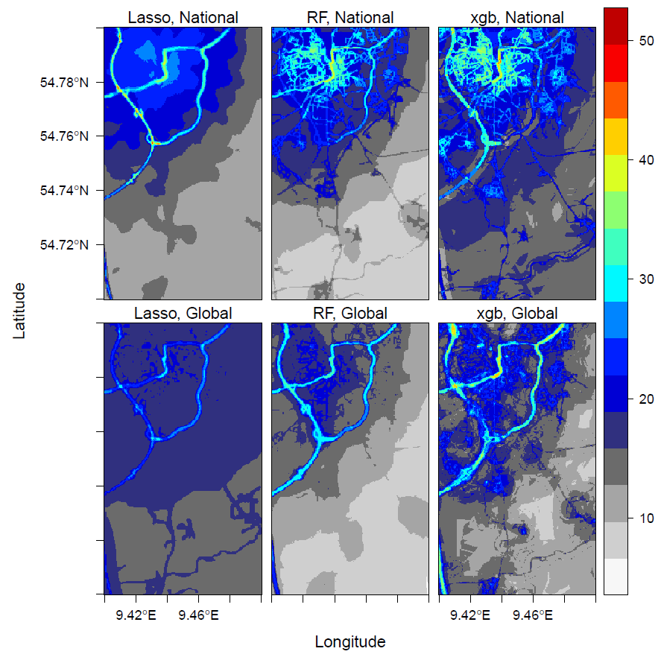
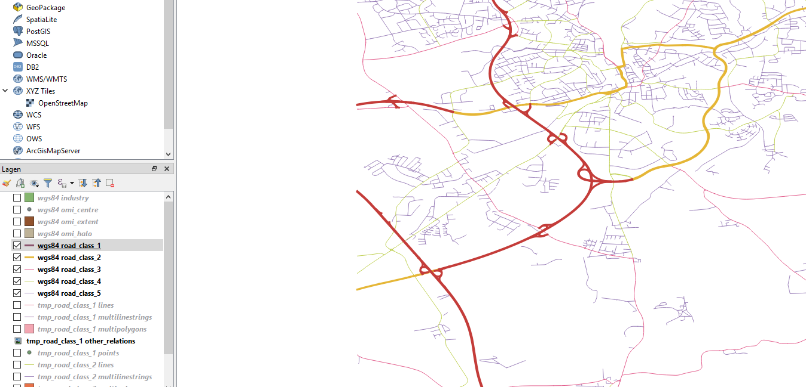
Germany
highway
primary

Slide 47
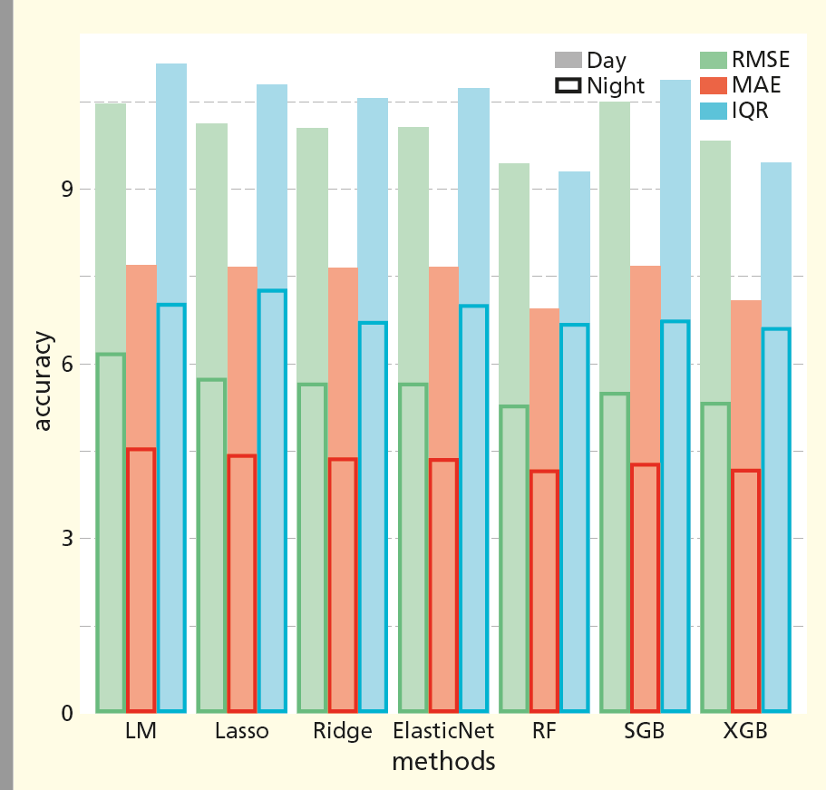
Germany
RMSE: root mean squared error
MAE: mean absolute error
IQR: interquartile range
LM: Multiple linear regression
RF: random forest
SGB: Stochastic gradient boosting
XGB: xgboost

Slide 48
Important emition-related variables
National model of Germany
Ranked top 20 by Random Forest Primary road 25m, 50 m, 100 m Local road 25m, 50 m, 100 m, 300 m Ranked top 20 by XGBoost Primary road 50 m, 100 m Highway 50 m Local road 25m, 50 m, 100 m, 300 m Selected by LASSO Primary road 25m, 50 m, 100 m Highway 50m, 100 m Local road 100 m, 300m
Global model
Ranked top 20 by Random Forest* Primary road 50 m, 100 m Ranked top 20 by XGBoost Primary road 50 m, 100 m Highway 100 m Local road 25 m, 50 m, 100 m Selected by LASSO Primary road 50 m, 100 m Highway 50 m, 100 m Local road 25 m, 50 m, 100 m
*Highway 100 m ranked 26

Slide 49
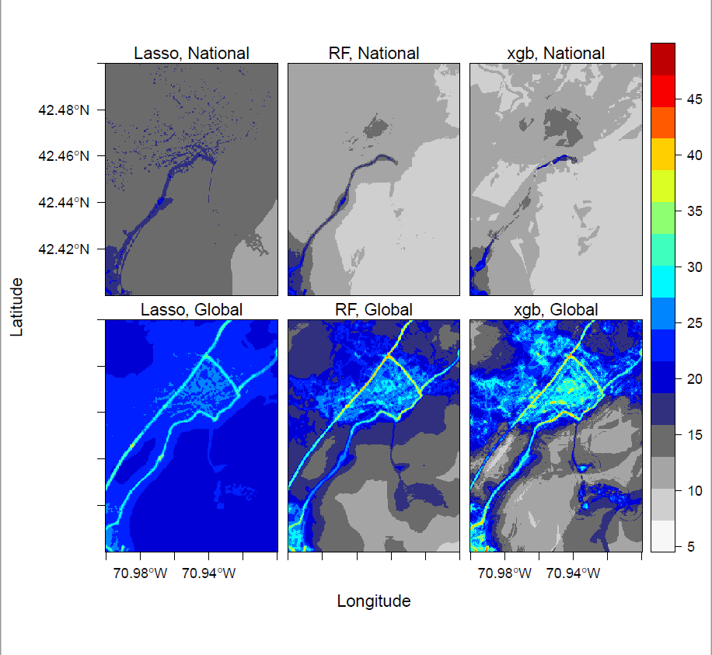
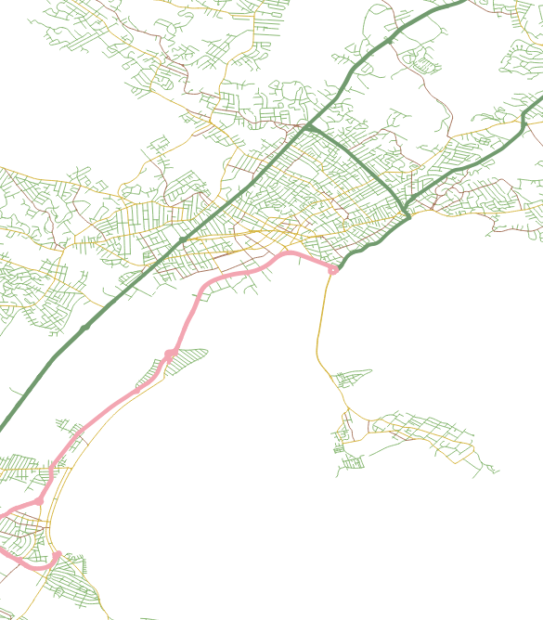
US
primary
highway

Slide 50
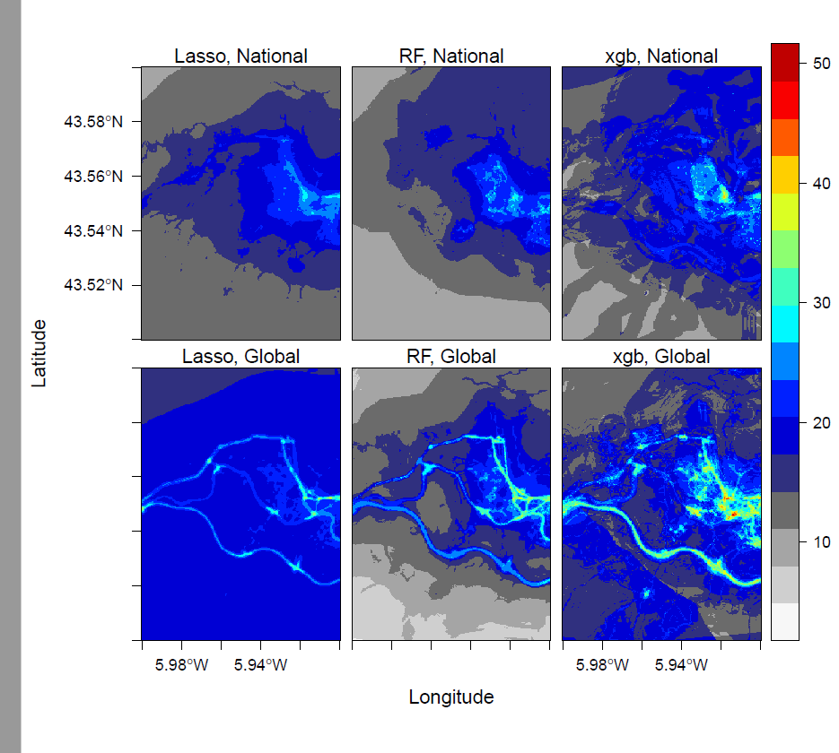
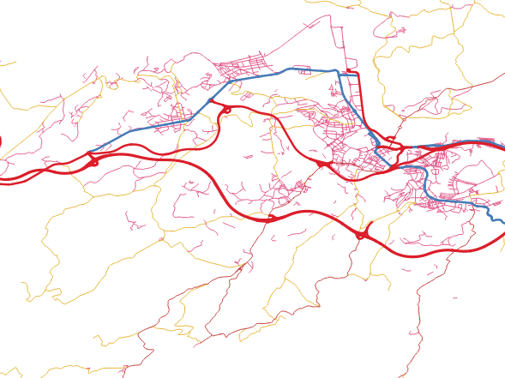
Spain
primary
highway

Slide 51
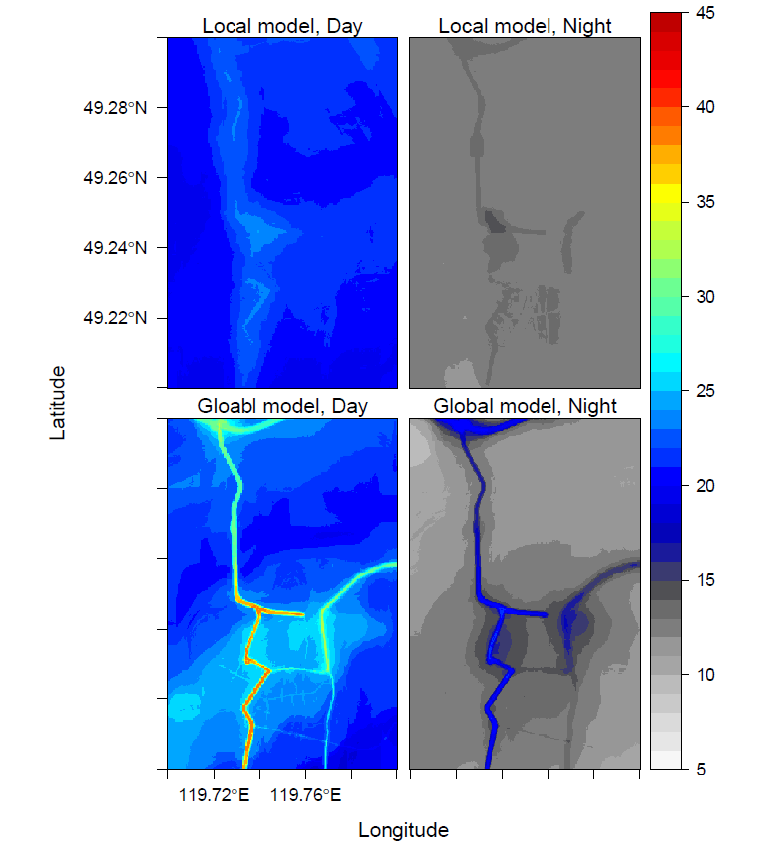
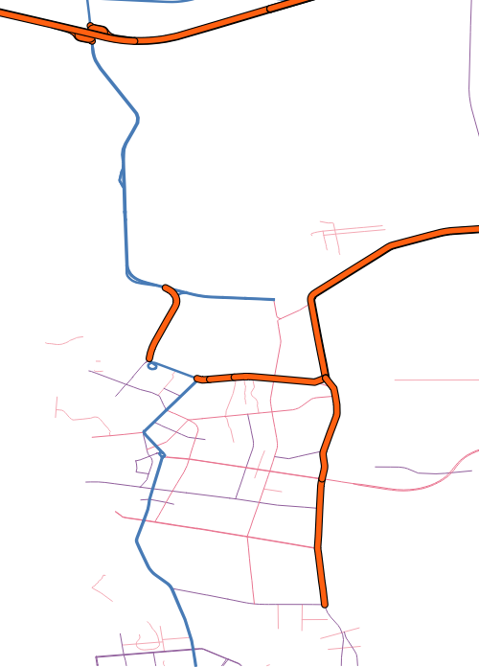
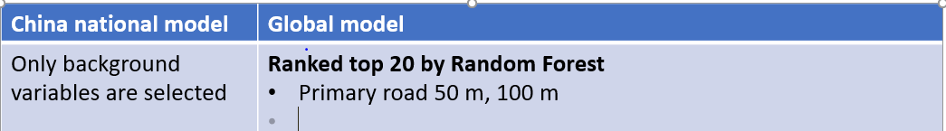
Random Forest
Prediction: China
primary
highway

Slide 52
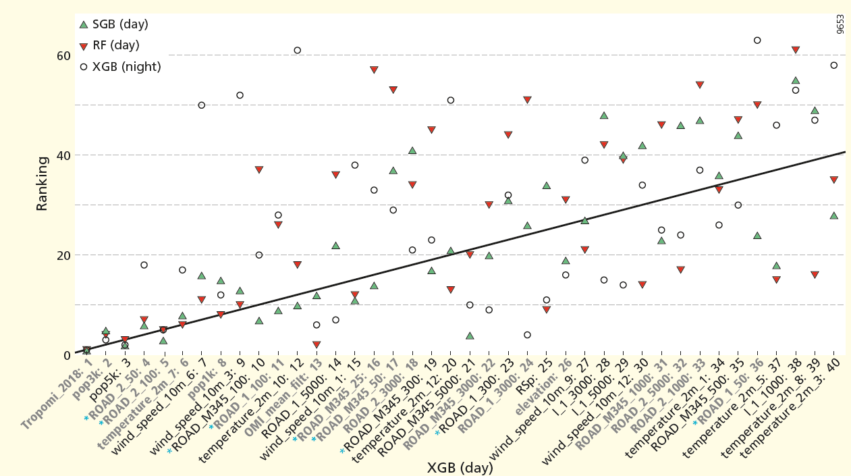
Variable importance
ROAD_M345: secondry and local roads
Pop_: population ROAD_2: primary roads
Global model

Slide 53

Variable importance
ROAD_M345: secondry and local roads
Pop_: population ROAD_2: primary roads
Germany

Slide 54



Using random forest for Geostatistic-like interpolation
http://rpubs.com/menglu/473973

Slide 55
Road length | https://www.openstreetmap.org/
Industrial area | https://www.openstreetmap.org/
Population | http://www.integrated-assessment.eu/eu/index.html
Elevation | https://www2.jpl.nasa.gov/srtm/
Wind speed | https://confluence.ecmwf.int/pages/viewpage.action?pageId=74764925
Temperature | https://confluence.ecmwf.int/pages/viewpage.action?pageId=74764925
TROPOMI | http://www.tropomi.nl
NO2 Surface product | http://fizz.phys.dal.ca/~atmos/martin/?page_id=232
OMI | https://mirador.gsfc.nasa.gov/cgi-bin/mirador/presentNavigation.pl?tree=project&dataset=OMNO2d.003&project=OMI&dataGroup=L3_V003&version=003&CGISESSID=57642d429543194f1007d9b91bfab0ae

Slide 56
Hyperparameters
nrounds:
Controls the maximum number of iterations.
Tuned by CV
Eta:
Controls the learning rate,
It must be supported by increase in nrounds.
max_depth:
It controls the depth of the tree. Larger data sets require deep trees to learn the rules from data.
Tuned by CV
Gamma:
Controls regularization (or prevents overfitting).
Higher the value, higher the regularization. Regularization means penalizing large coefficients which don't improve the model's performance.
If you see train error >> test error, bring gamma into action.
Norms:
L1 norm (alpha) and L2 norm (lambda)

Slide 57






Convolution and deconvolution

